Slide 1

TIER 0
Business Critical
Data, Privileged Identities
& Intellectual Property
TIER 1
Important but not business critical
TIER 2
Standard Users, Low sensitivity data, Public Information

Slide 2
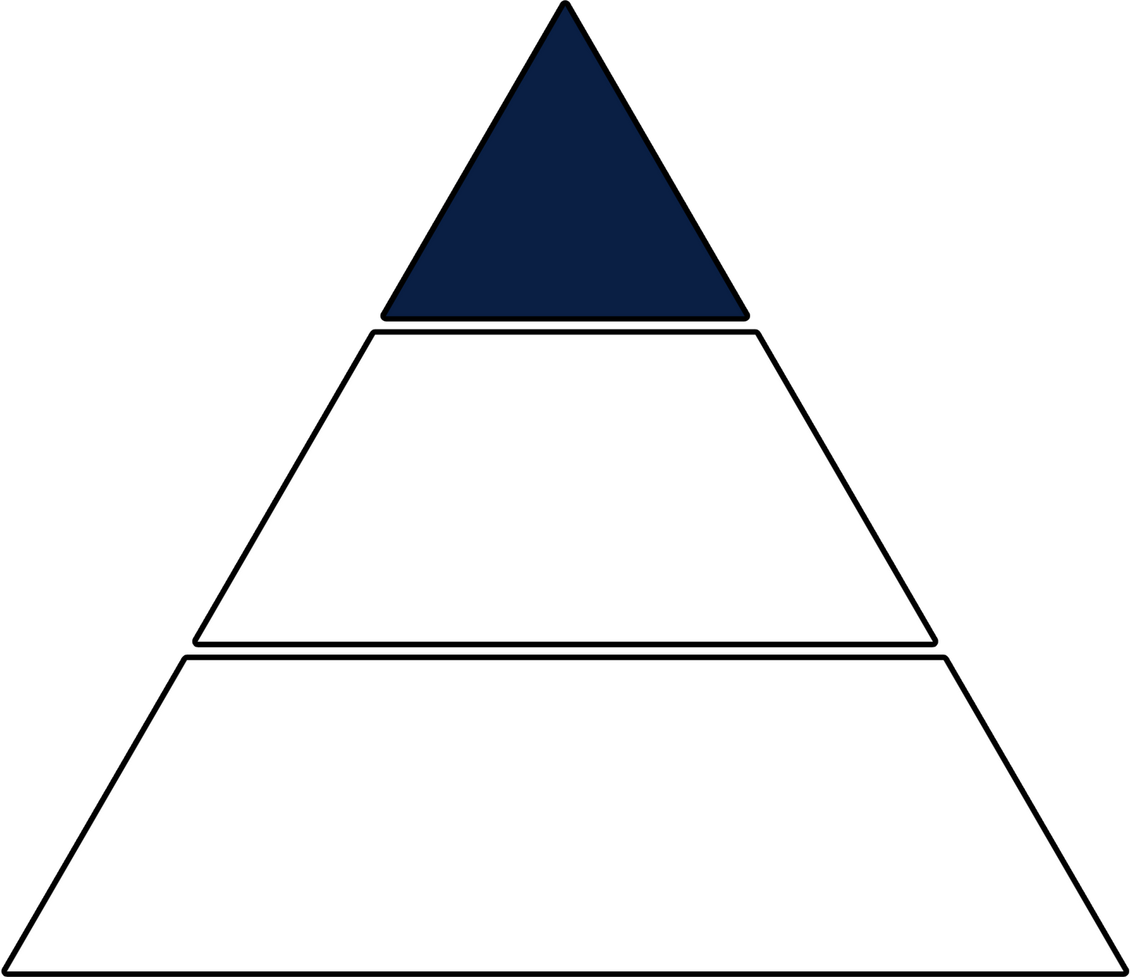

TIER 0
TIER 1
important but not
business critical
TIER 2
User / Public Information

Slide 3
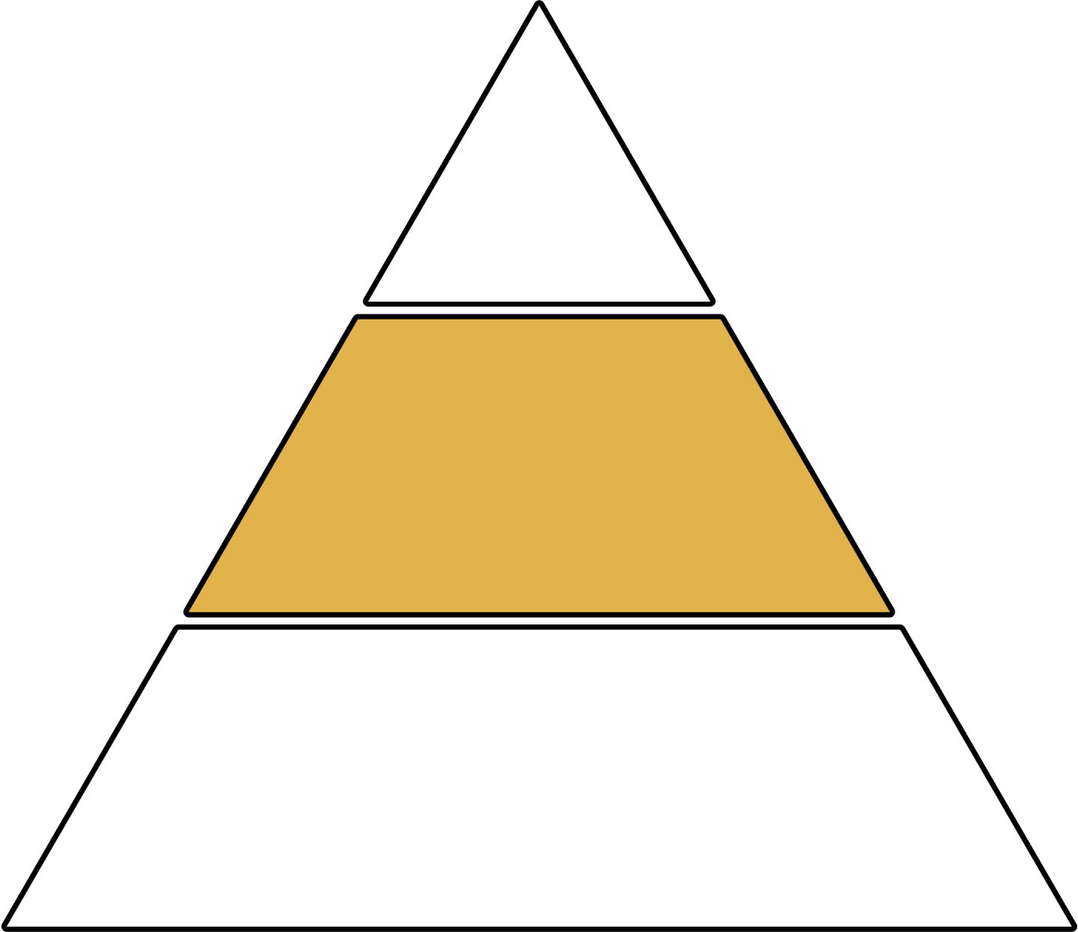
TIER 0
TIER 1
important but not
business critical
TIER 2
User / Public Information

Slide 4
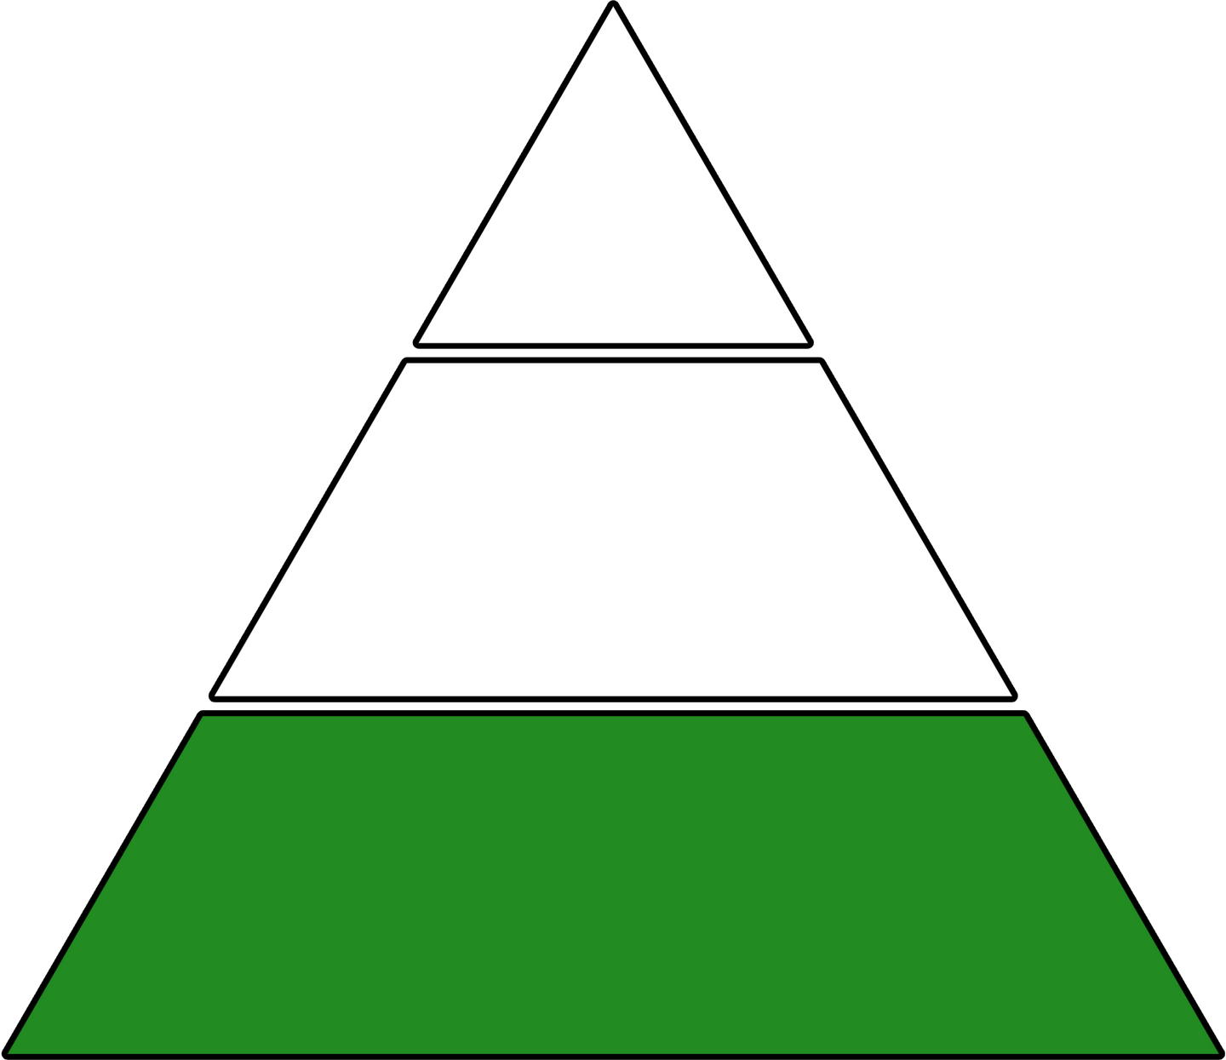
TIER 0
TIER 1
important but not
business critical
TIER 2
User / Public Information

